Slide 1


ZCF Innovation

Slide 2
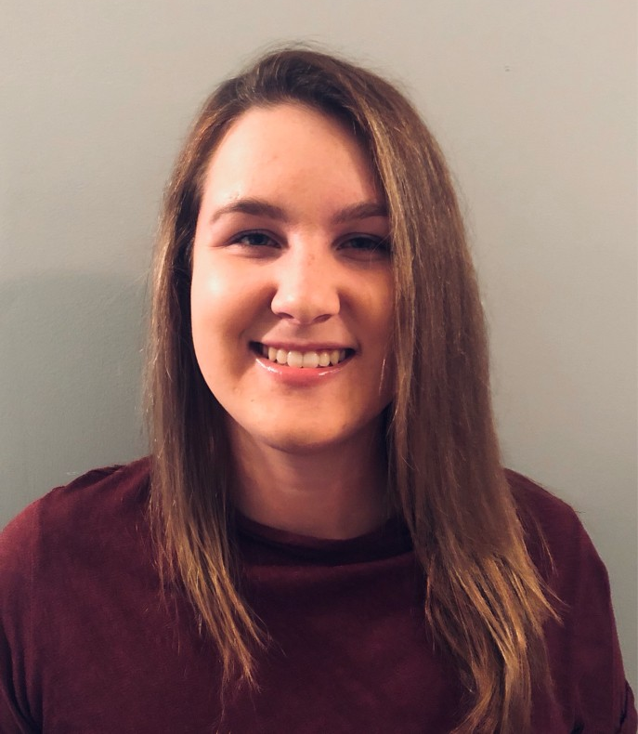
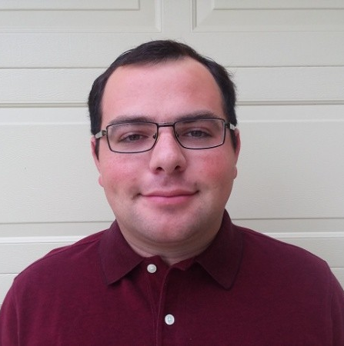
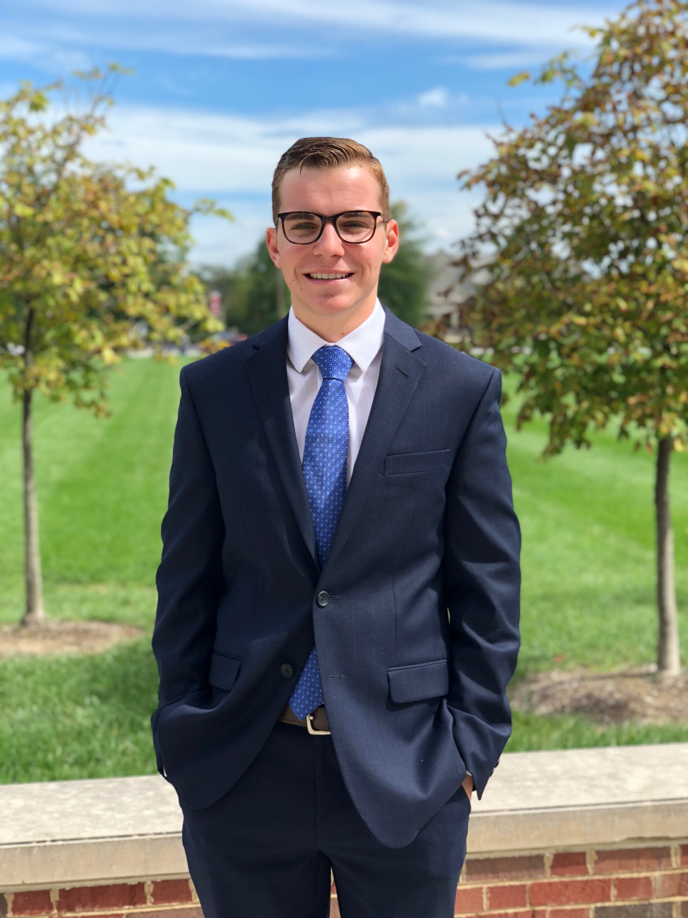
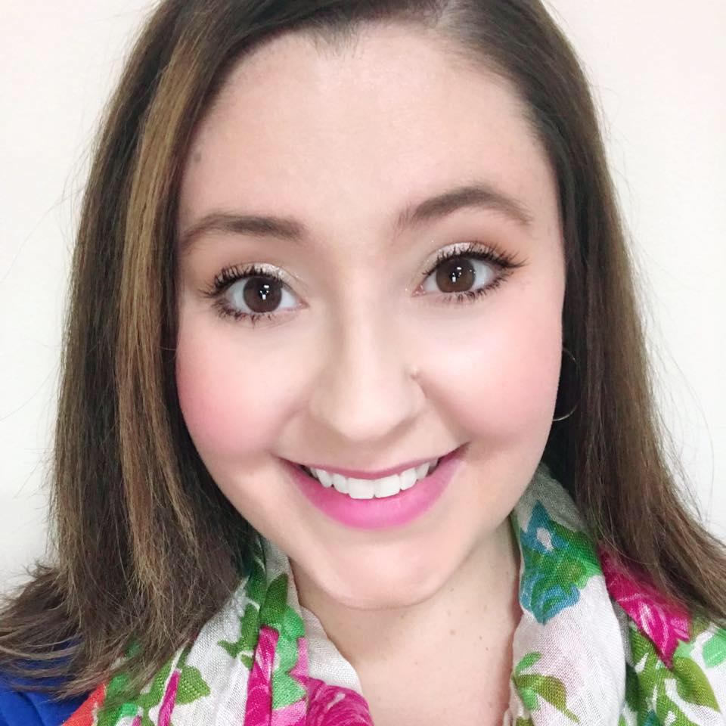
Our Team
Amara Cummins
Miami University
John Hoyt
University of Cincinnati
Jillian Nolte
University of Cincinnati
Connor Wolfe
Miami University

Slide 3
What’s the Problem?
“The nature of student engagement has changed. As a company that values the talent and ideas that college students bring, we want to ensure that we're engaging with students on their terms. The goal of this challenge is to create a tool that will allow us to collect valuable information about a student's experiences and interests in order to partner through internships, co-ops, and other opportunities.”

Slide 4
What do we experience at recruiting events?
Negative career fair experiences
“Keep your resume, you’re just a freshman”
“Come talk to us when you’re a junior”
Intern application auto-rejected within 30 minutes
Discussing the resume
Focused on the bullet points, not who we are as people

Slide 5
What do we want to experience?
We want an opportunity to prove our worth →
Showcase work ethic and willingness to learn
Not always based on experiences and background
Candidate does not need to “check the box”
Key: A new recruiting methodology that does not focus on a resume.

Slide 6
What’s the value to you?
Create an environment where students and employees with similar interests can engage in meaningful discussions.
Build a stronger entry-level work force
Create a robust, long-term, and iterative talent pipeline
A scalable methodology and tool that can be offered to other organizations

Slide 7
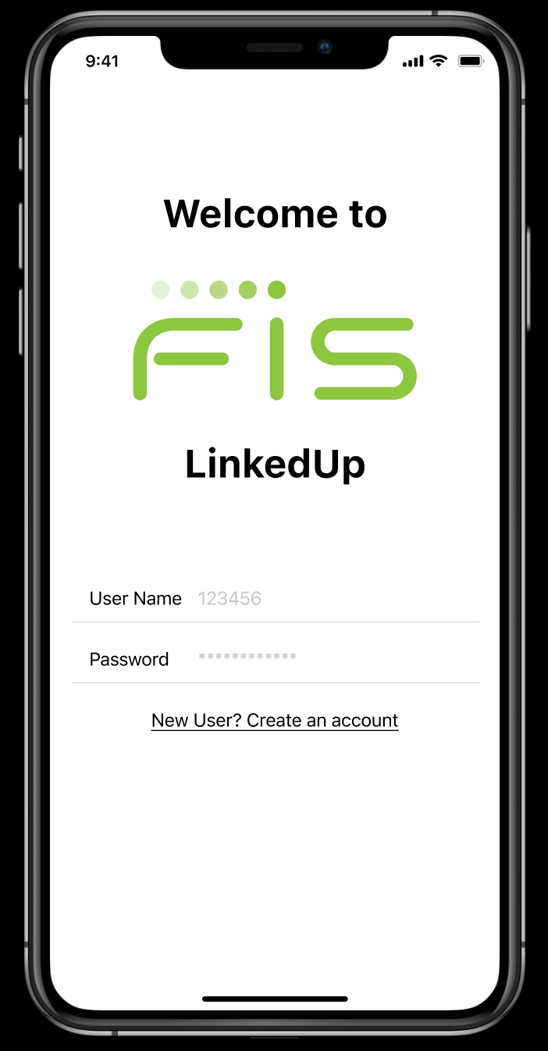
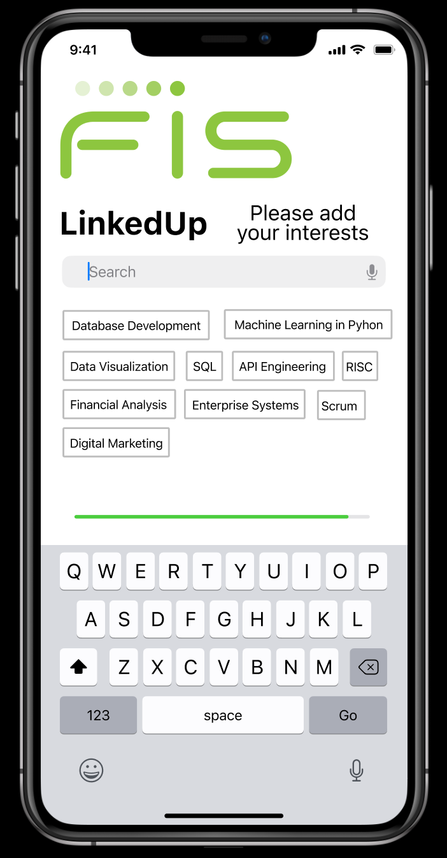
Interactive Wireframe Demonstration
Let’s take a look at an interactive wireframe showcasing LinkedUp’s functionality

Slide 8
Thank you!
Questions?

